Slide 1

Introduction To Management
Course Code: GC152
Lecture # 06
By
ISLAM ZADA
Lecturer in Department of Computer Science & Software Engineering,
International Islamic University, Islamabad.

Slide 2
Element of scientific management
limitations of scientific approach of management
business operation
14 principles of management
Hierarchy of need theory.

Slide 3
Element of scientific management
It is a classical management approach that emphasizes the scientific study of work methods to improve the efficiency of the workers:
Scientific Task Planning: Scientific task planning is all about the total amount of work an average worker can do during a day under normal conditions. Management should decide in advance what work is to be done, by whom, where and when.
Time Study: The time study indicates that minimum time required finishing a particular job.
The time study would indicate the time taken by workers to finish particular job is being recorded first and this information is being used to develop standard time.

Slide 4
Element of scientific management
Motion study: Motion study is useful to find out best order of activity to do a particular job.
Functional Foremanship: In order to achieve better production control, Taylor has given the concept of foremanship.
Where the factory has divided into various department.
And each department has in-charge of specialist.
These functional foremanship playing role of specialist and provide expert advice to workers.

Slide 5
Element of scientific management
Standardization: In scientific Management standards have to be set well in advance for the task, materials, work method, quality, time, and cost and working condition etc.
This helps in simplifying the process of production and which reduce waste, improve quality of product and maximum utilization of available resources.
Differential piece rate system: In order to motivate workers, incentive based wage system has been developed.
This concept of piece rate system is based on competence of workers.
The competent workers are paid more wages than incompetent one.
It also encourages incompetent workers to improve their performance and achieve their standards.

Slide 6
Limitations of scientific approach of management
Limitations of scientific approach of management given by F. W. Taylor
Unfair mechanism: Scientific Management main objective is to increase workers’ productivity but management did not share the benefits of increased productivity with workers.
Depersonalized Work: Scientific management everything is standardized. In short, workers have to do work repeatedly.
These generate monotony and boredom..

Slide 7
Limitations of scientific approach of management
Un-psychological: In scientific Management there is no specific information given that how wages should be distributed as a result it becomes un-psychological.
Unoriginal: F.W. Taylor has copied this approach from someone else’s approach.
Unrealistic: F.W.Taylor has not believed in motivation, financial needs also.
That is the reason why this concept is unrealistic.

Slide 8
Explain business operation given by Henry Fayol
The business operations of an organization could be divided into six activities
Technical: producing and manufacturing products.
Commercial: Buying, selling and exchange.
Financial: Search for an optimal use of capital.
Security: protecting an employees and property.
Accounting: recording and taking stick of costs, profits and liabilities, maintain balance sheets, and compiling statistics.
Managerial: planning, organizing, commanding, coordinating and controlling.

Slide 9
14 principles of management given by Henry Fayol
The business operations of an organization could be divided into six activities
Division of work: According to Henry Fayol work should be divided and subdivided with various individual according to their expertise skills and knowledge in a particular area.
With division of work it helps individual in acquiring speed, accuracy in his performance. Specialization leads to efficiency and effectiveness for organization.
Authority and Responsibility: The concept of authority and responsibility are closely related.
Authority was defined by Fayol as the right to give orders and powers to match duty.
Responsibility involves being accountable, and is therefore naturally associated with authority. Whoever assumes authority also assumes responsibility.

Slide 10
14 principles of management given by Henry Fayol
Unity of command: Subordinates should receive orders and be answerable to one and only one boss at a time. In other words, subordinates should not receive instructions from more than one person.
Unity of command provides the enterprise of disciplined, stable and orderly existence. It creates harmonious relationship between superiors and sub-ordinates.
Unity of Direction: the entire organization should be moving towards a common direction.
According to this principle, efforts of all the members of the organization should be directed towards common goal.

Slide 11
14 principles of management given by Henry Fayol
Scalar Chain: Managers in hierarchies are part of a chain like authority scale. Each manager, from the first line supervisor to the president, possesses certain amounts of authority.
The President possesses the most authority; the first line supervisor the least. Lower level managers should always keep upper level managers informed of their work activities.
The existence of a scalar chain and adherence to it are necessary if the organization is to be successful.
Discipline: According to Fayol, “Discipline means sincerity, respect of authority and observance of rules and regulation of the enterprise”.
This principle applies that subordinate should respect their superiors and obey their order.

Slide 12
14 principles of management given by Henry Fayol
Initiative: Workers should be encouraged to take initiative in the work assigned to them.
Fayol advised to them. Fayol advised that management should provide opportunity to its employees to suggest ideas, experiences and new method of work.
Fair remuneration: Fayol suggested that remuneration to be paid to the workers should be fair, reasonable, satisfactory and rewarding of the efforts.
As far as possible remuneration should satisfy employer as well as employee.
Fayol also recommended provision of other benefits such as free education, medical and residential facilities to workers.
Stability: Fayol emphasized that employees should not be moved frequently, from one job to another.

Slide 13
14 principles of management given by Henry Fayol
Stability of Tenure of Personnel: Retaining productive employees should always be a high priority of management.
Recruitment and Selection Costs, as well as increased product-reject rates are usually associated with hiring new workers.
Espirit de Corps: Management should encourage harmony and general good feelings among employees.
.

Slide 14
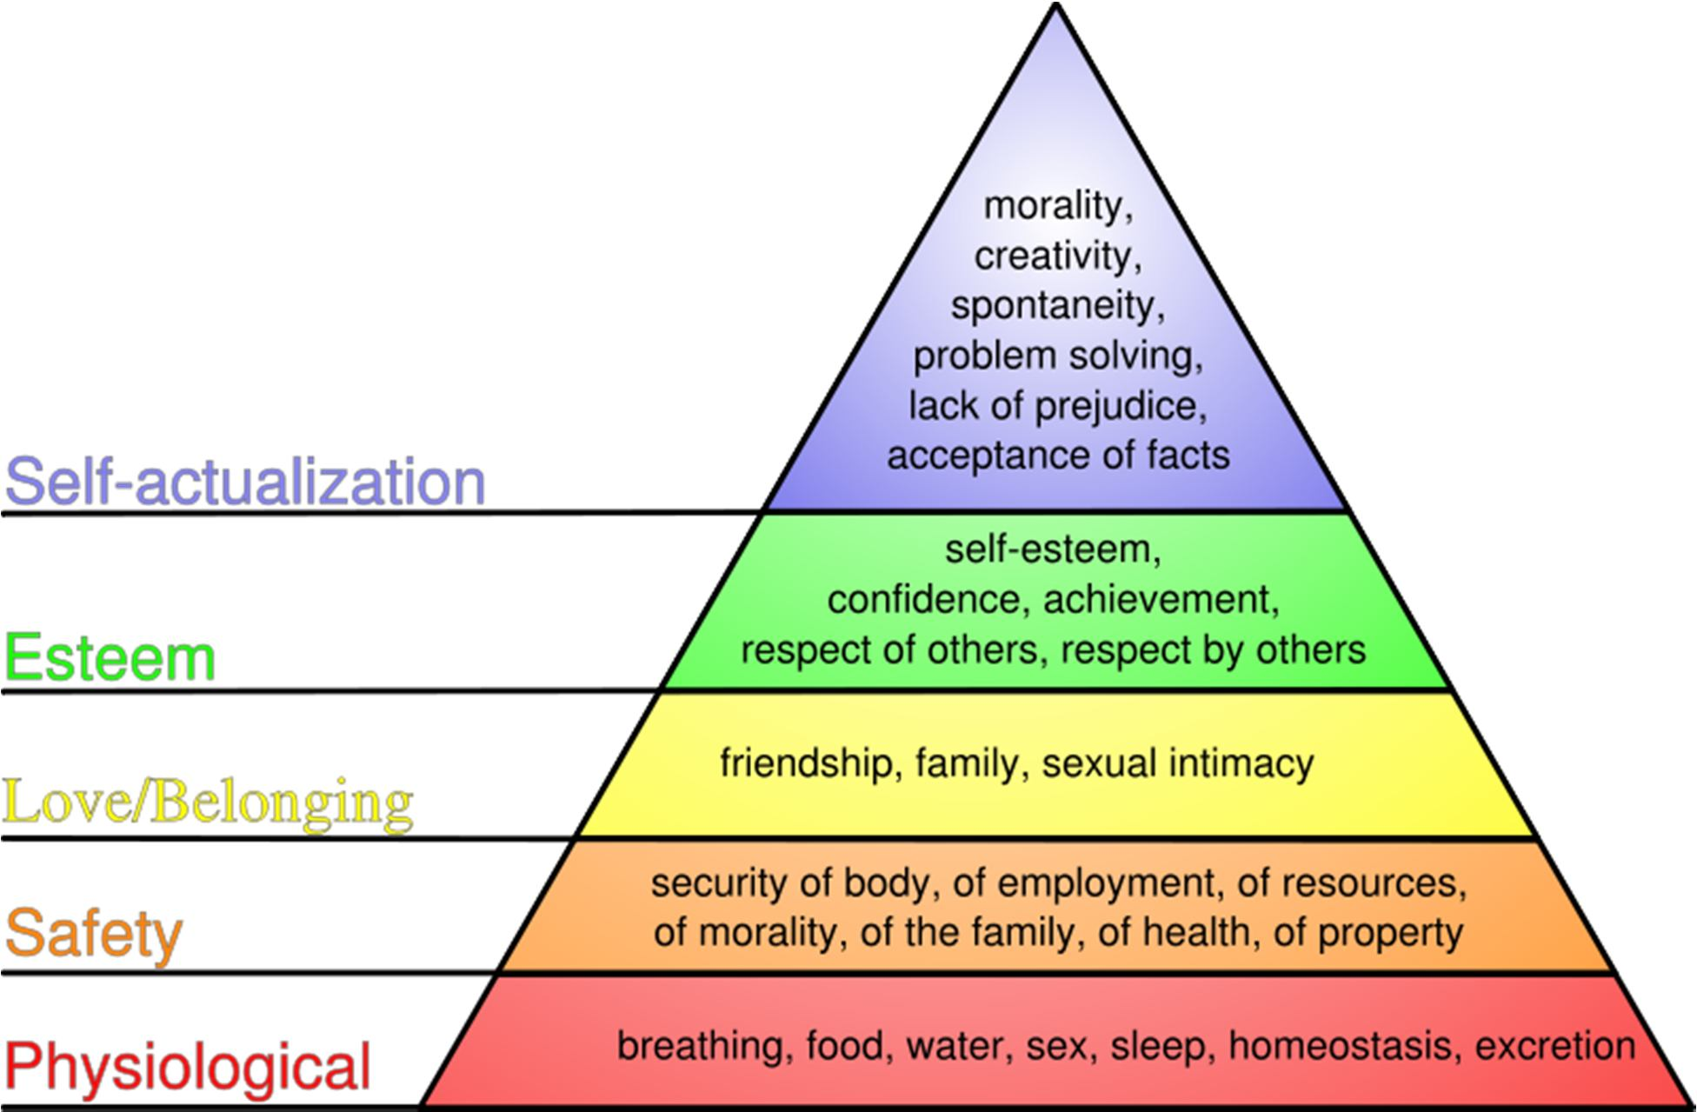
Hierarchy of need theory

Slide 15
Introduction to Management, 13th Edition International Student Version, John R. Schermerhorn Jr., Daniel G. Bachrach, ISBN: 978-1-118-95118-7
Introduction to Management-4th Edition. Author(s):Richard Pettinger, publisher: Red Globe Press.

